Slide 1
2018 Articulation Conference Update

Slide 2
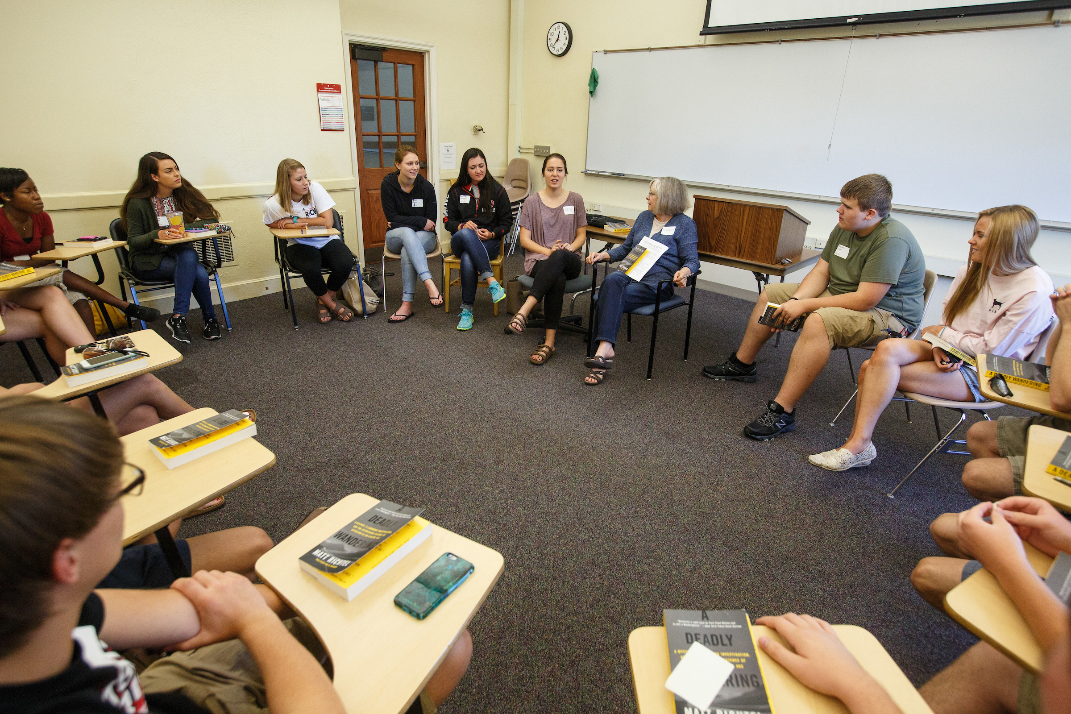
Fall 2017 Enrollment Update
1,251 new transfer students
8.1% increase of underrepresented students
12,624 total undergraduate students
15,731 total UNO students

Slide 3
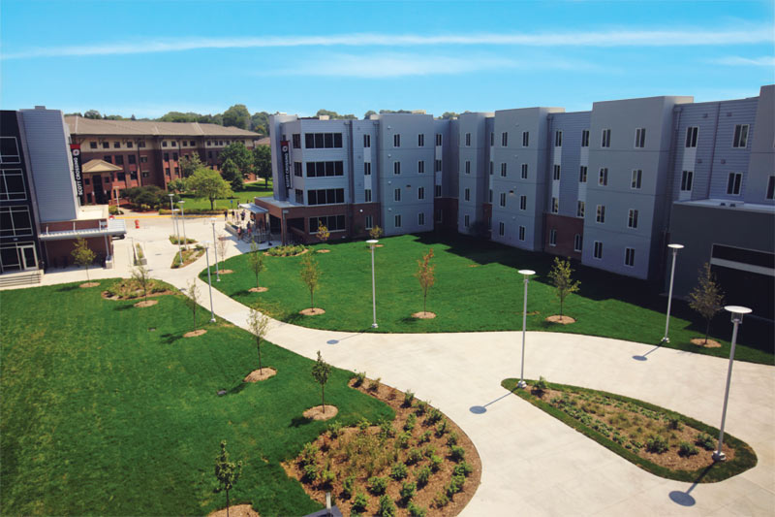
Scott Crossing

Slide 4
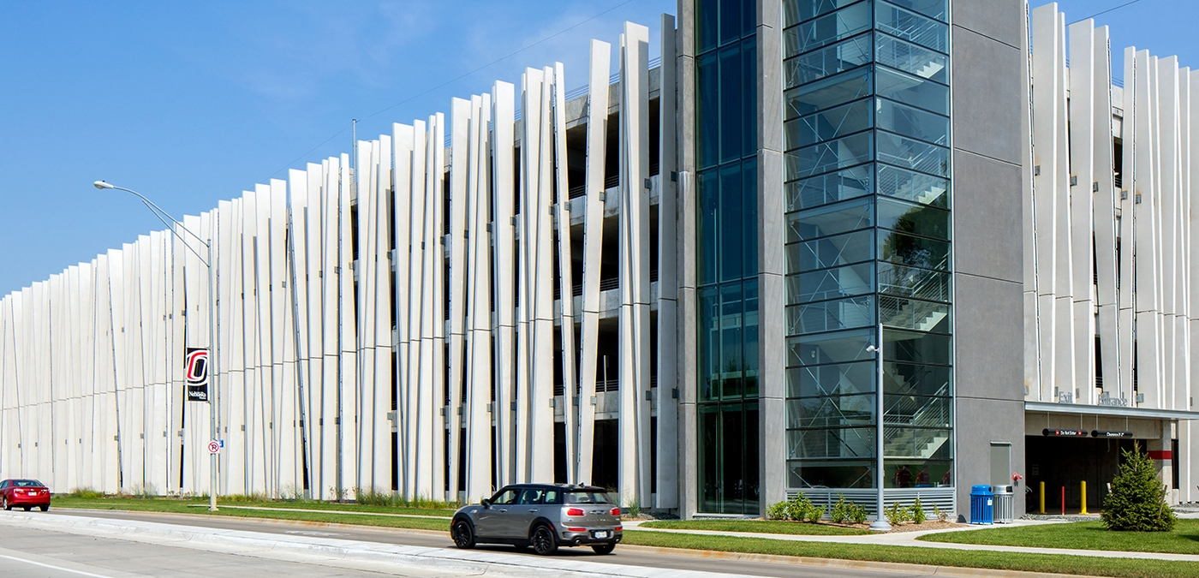
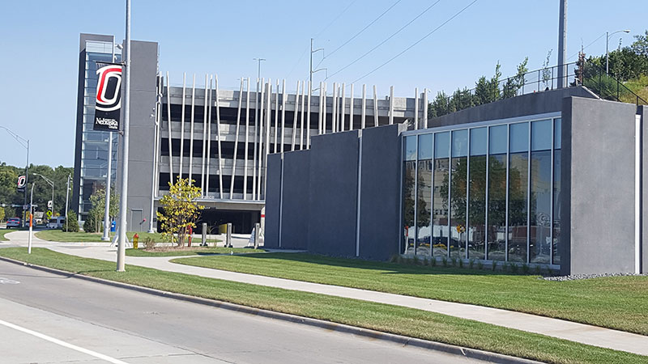
Scott Campus Parking Garage

Slide 5
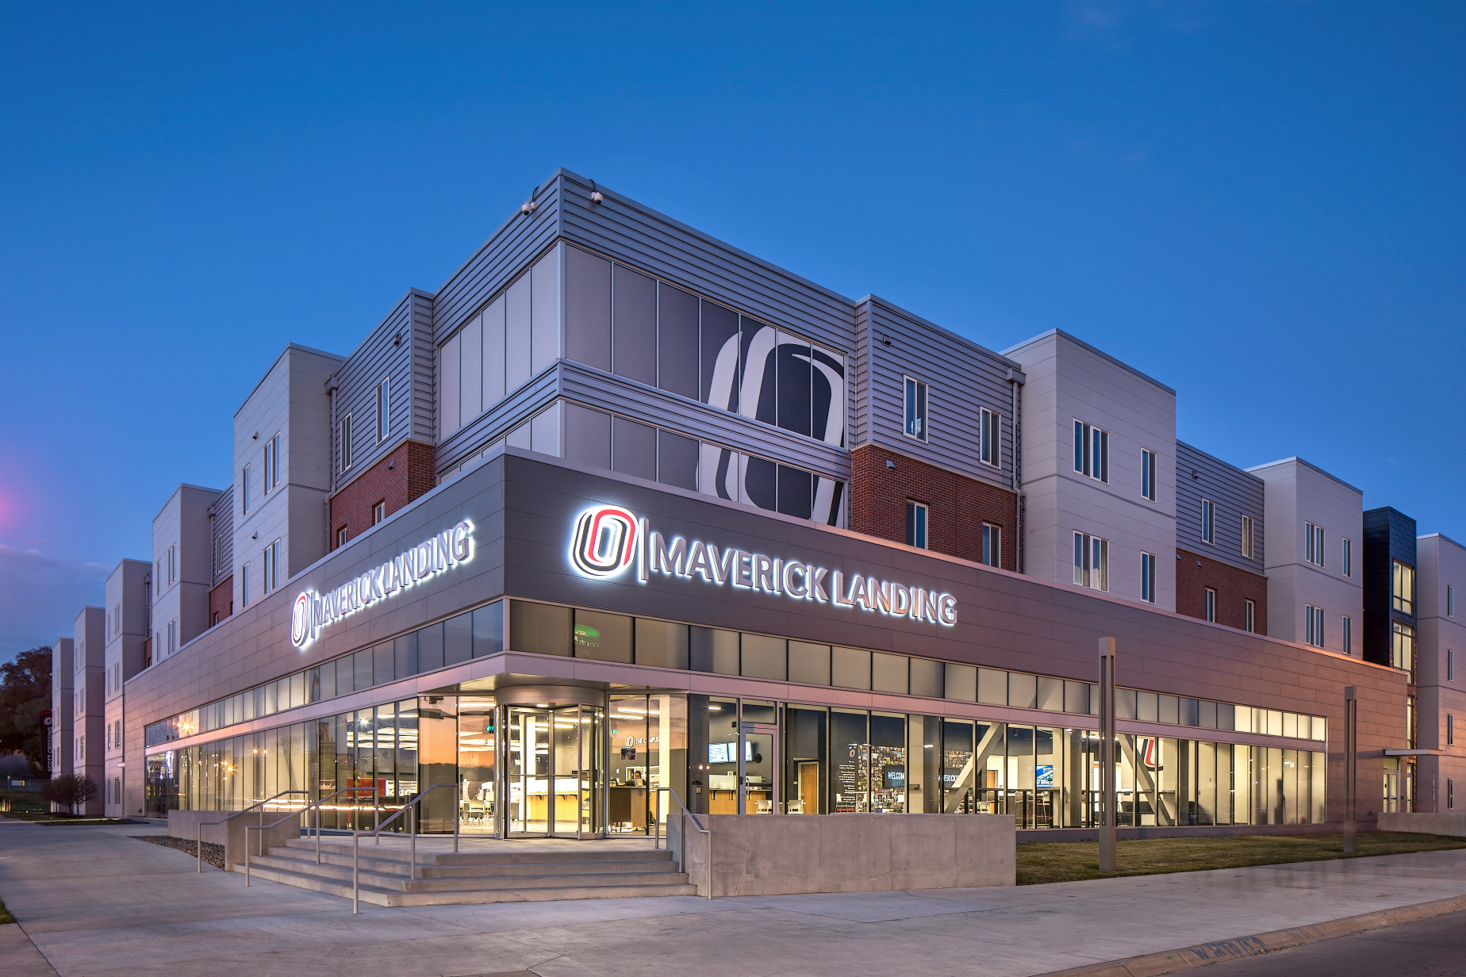
Maverick Landing

Slide 6
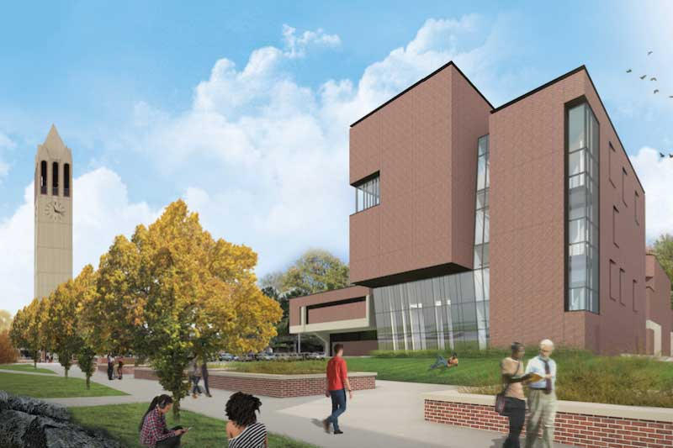
Strauss Performing Arts Center

Slide 7
Program Name Change
Bachelor of General Studies
To
Bachelor of Multidisciplinary Studies
50+ areas of concentration
Online degree audit
Many online concentrations

Slide 8
General Education Math Changes at UNO
There are 3 main components of UNO’s General Education Curriculum
Fundamental Academic Skills (15 credits)
Includes Composition (9 credits), Public Speaking (3 credits), and Mathematics (3 credits)
Distribution Requirements (25 credits)
Natural Science (7 credits representing two disciplines with at least one lab course)
Social Sciences (9 credits representing at least two disciplines)
Humanities/Fine Arts (9 credits representing at least two disciplines)
Diversity (6 credits)
U.S. Diversity (3 credits)
Global Diversity (3 credits)

Slide 10
General Education Math Changes at UNO FAQs
Will MATH 1310 (Intermediate Algebra) continue to be offered at UNO?
No, MATH 1310 will no longer be offered starting in the Fall of 2018. Students placing into mathematics at a level below College Algebra will take a new course called MATH 1210 (Intermediate Algebra). However, this course will not fulfill a General Education requirement, nor will the credits count towards the 120 credit hour minimum required for a degree. This course will prepare students to be successful in the next higher level mathematics course
Why is UNO eliminating MATH 1310 (Intermediate Algebra)
UNO needed to align its General Education curriculum more closely to peer institutions where College Algebra is typically the baseline mathematics requirement.
Will MATH 1310 (Intermediate Algebra) continue to fulfill degree plans if I took the course prior to Fall 2018?
Yes, MATH 1310 will continue to be allowed to fulfill degree plans for current and transfer students as the math Gen Ed course and toward the 120 credit hour requirement if the student took the course (or its equivalent) prior to the Fall 2018 semester.

Slide 11
General Education Math Changes at UNO FAQs
What are the placement guidelines for the new Math courses?
These have been updated and are located on UNO’s website (https://www.unomaha.edu/enrollment-management/testing-center/placement-exams/algebra-and-calculus-compass-exam.php)
What is the difference between MATH 1220 (College Algebra) and MATH 1120 (Mathematical and Computational Thinking)?
MATH 1120 embraces the visual arts to introduce students to the foundational elements of mathematical and computational thinking from which algebraic functions and corresponding functions in computer programs are reasoned. This course would not be appropriate for students whose program of study requires Pre-calculus, advanced statistics, or other courses that require MATH 1220 (College Algebra) as a pre-requisite.

Slide 12
Transfer Webinar
Admitted students get e-mail invitation
Review
Transfer Credit Report
Financial Support & Scholarships
Holds/next steps
Support at UNO

Slide 13
Transfer Success Scholarship
$1000/year
Some awards specifically for Phi Theta Kappa or Phi Theta Kappa eligible students
April 15 Application Deadline
Eligibility
First-time UNO students with at least 12 transferable hours
2.5 GPA
Complete application with resume & short essay
Must be admitted to apply
Renewal
Renewable for 3 years or until graduation
3.0 GPA & full-time status required for renewal

Slide 14
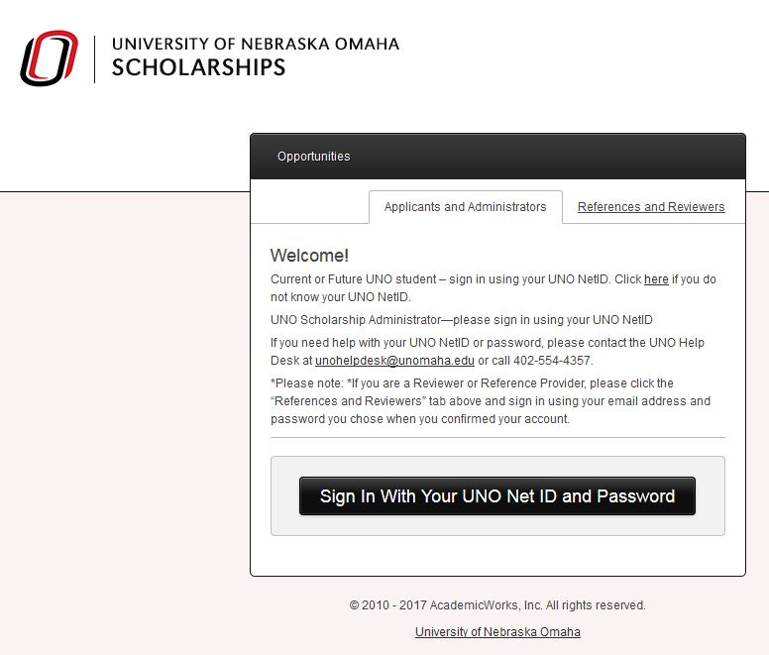
Scholarships
Notes:
Students will use their NetID and password to log in. The helpdesk contact information is shown in case they have trouble determining what their NetID is or need the password reset.

Slide 15
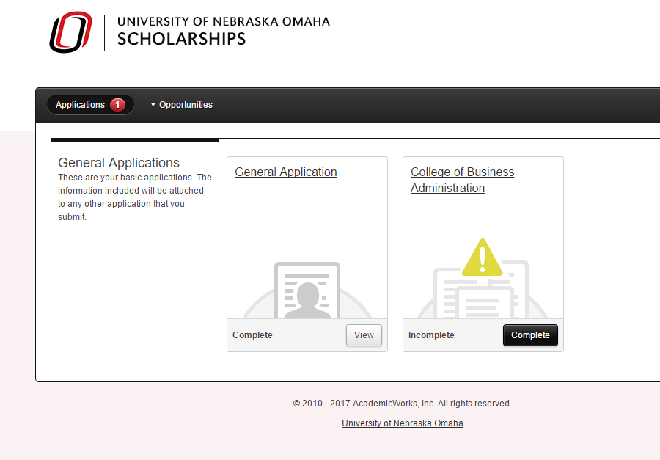
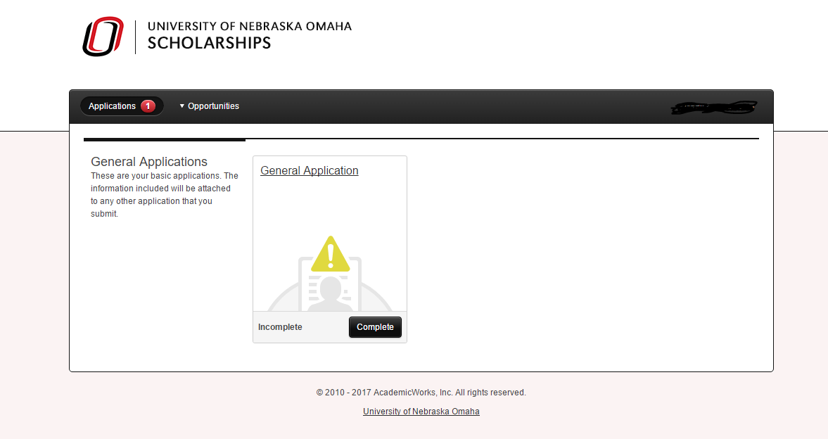
Scholarships
Notes:
Once logged in the student will see a page that looks like this directing them to complete the General Application. All students are required to complete this application, which requires that a resume to be uploaded.
If the student meets the qualifications to complete a conditional application, they will see it on their application screen. If they meet the basic qualifications for an apply-to scholarship such as the Transfer Success Scholarship they will want to click on Opportunities to see those recommended to them.

Slide 16
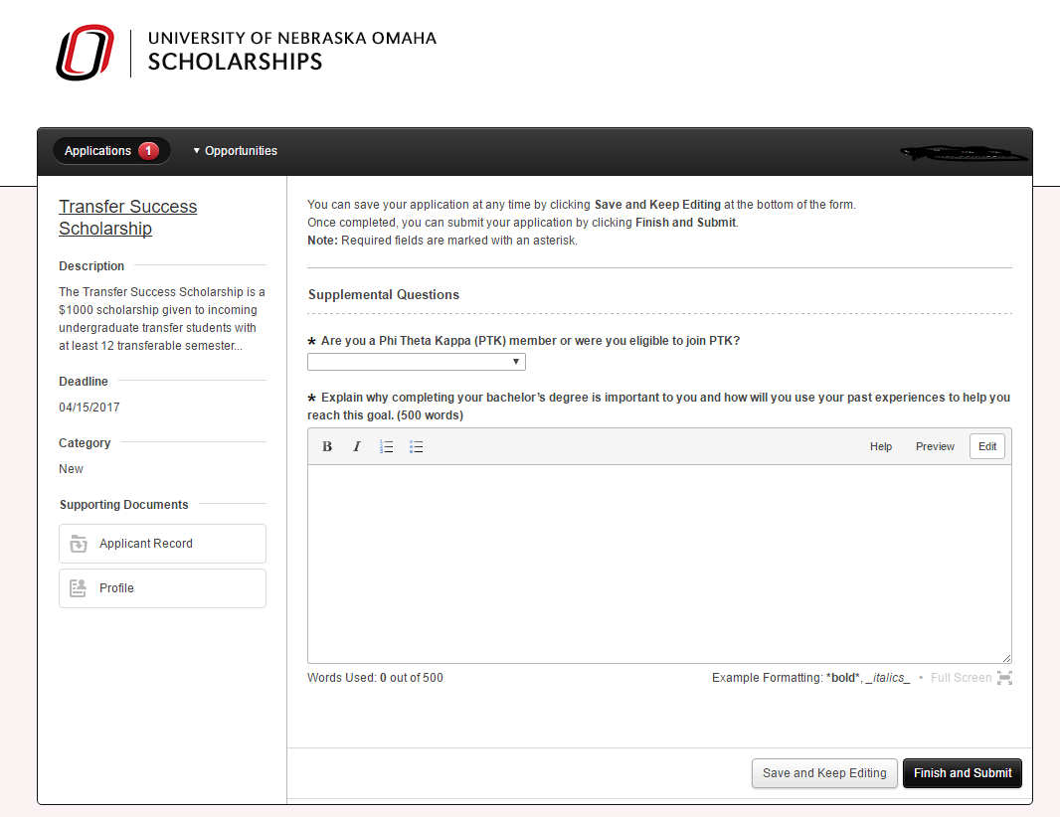
Scholarships
Notes:
Once the student clicks on the Transfer Success Scholarship, they will see this screen that allows them to complete the supplemental questions and essay required for consideration.

Slide 17
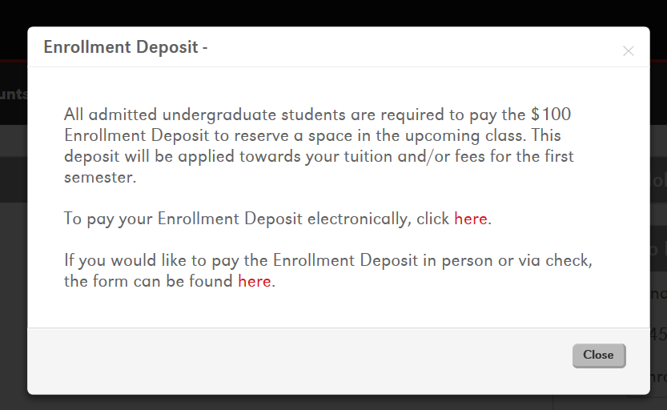
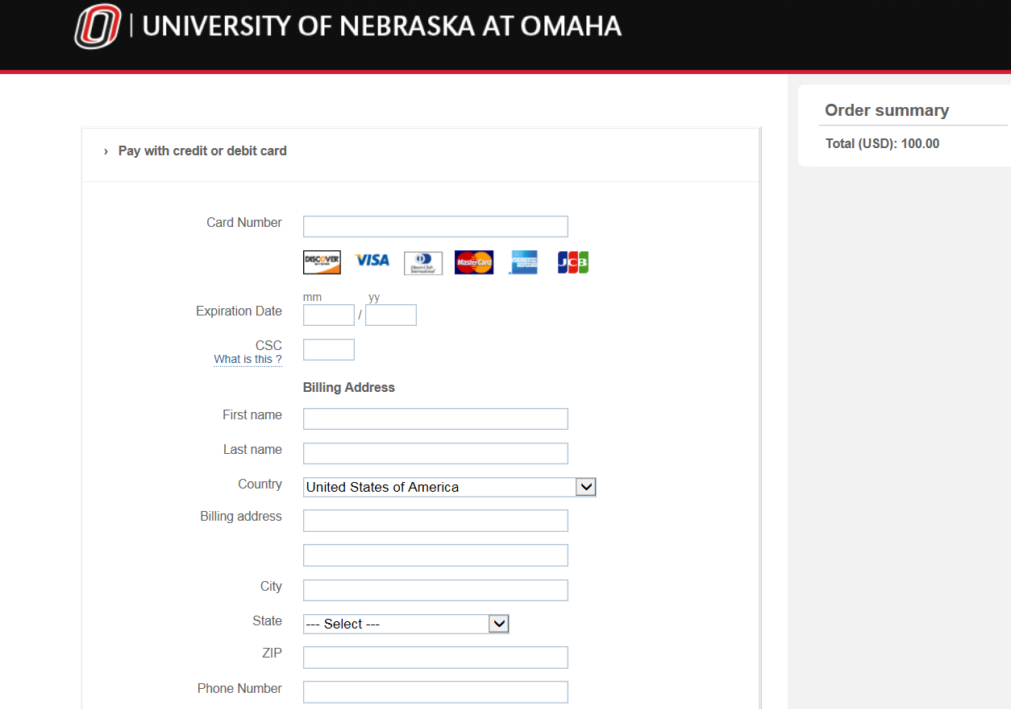
Enrollment Deposit
$100 deposit
Goes towards first bill
Reserves their space in the upcoming class
Due by May 1
Students applying/admitted afterwards should still pay
Contact admissions representative for waiver options
Notes:
Your next step, if you have not already, is to pay the enrollment deposit. Can access from to do list….
Pay via secure PayPal link

Slide 18
Transfer Student Orientation
All transfer students are eligible for online orientation
May say August date when signing up – last day to complete
Students are responsible for setting up academic advising
Transfer students are encouraged to visit campus
Notes:
If students select online orientation, it is still taking 24 or so hours to get them access, as long as they have done their Confirmation of Admission at least one day prior to registering for orientation. If they do their confirmation of admission and register for orientation on the same day, it takes 48 hours to get them access to the online orientation. We are lifting orientation holds at least twice per business day and they need to successfully pass the post-orientation quiz with a 70% or better before it is lifted.

Slide 19
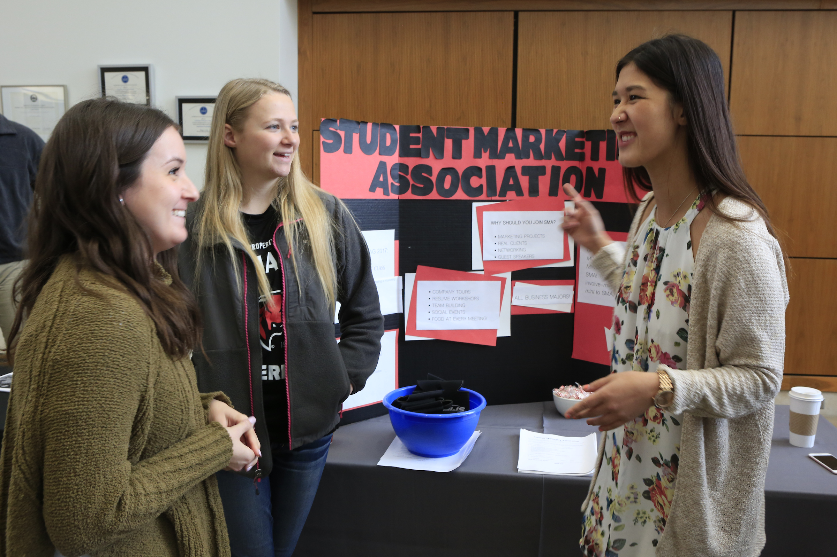
Transfer Student Visits
UNO Transfer Days
Daily Campus Visits
Group Visits
Individual Meetings with Admissions

Slide 20
The University of Nebraska does not discriminate based on race, color, ethnicity, national origin, sex, pregnancy, sexual orientation, gender identity, religion, disability, age, genetic information, veteran status, marital status, and/or political affiliation in its programs, activities, or employment.

