Slide 1

Budget Overview
Fiscal Year 2026-27

Slide 2

FUND DEFINITIONS
GENERAL FUND
State tax revenue allocated to the University.
CASH FUNDS
Derived from tuition, fees, investment income, and other miscellaneous income.
FEDERAL FUNDS
Provided by federal agencies for research, grants and contracts, and student aid programs.
REVOLVING FUNDS
Self-generated from departmental sales, charges for housing, food services, etc.
TRUST FUNDS
State and private gifts, grants, and contracts, non-federal student aid programs, etc.

Slide 3
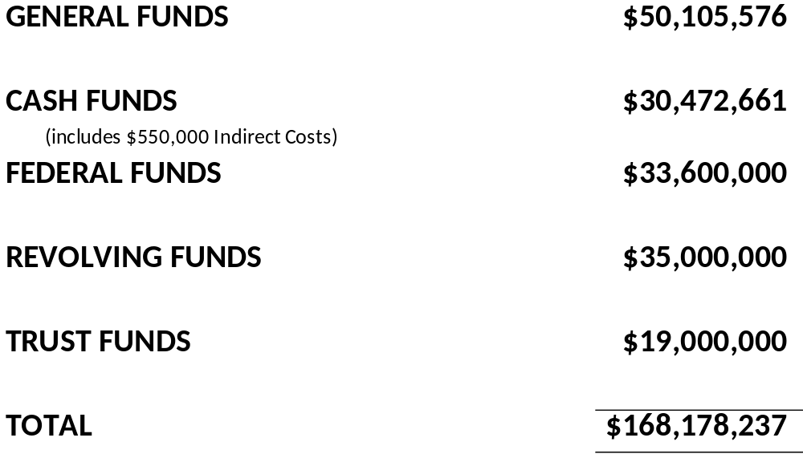
2026-27 Operating Budgets
Estimated Revenue by Fund Source

Slide 4
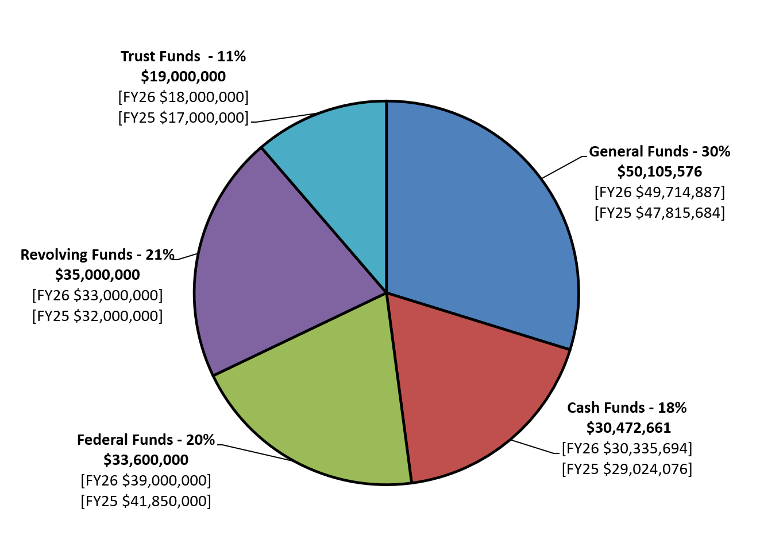
2026-27 Operating Budgets
Estimated Revenue by Fund Source

Slide 5
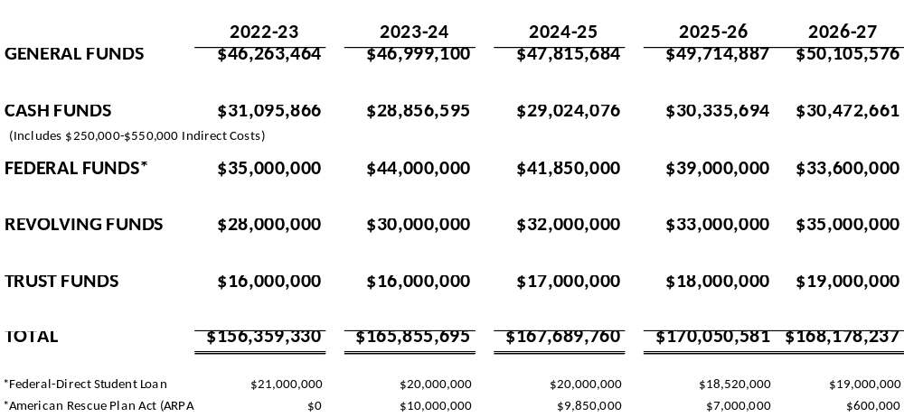
Historical Operating Budgets
Estimated Revenue by Fund Source

Slide 6
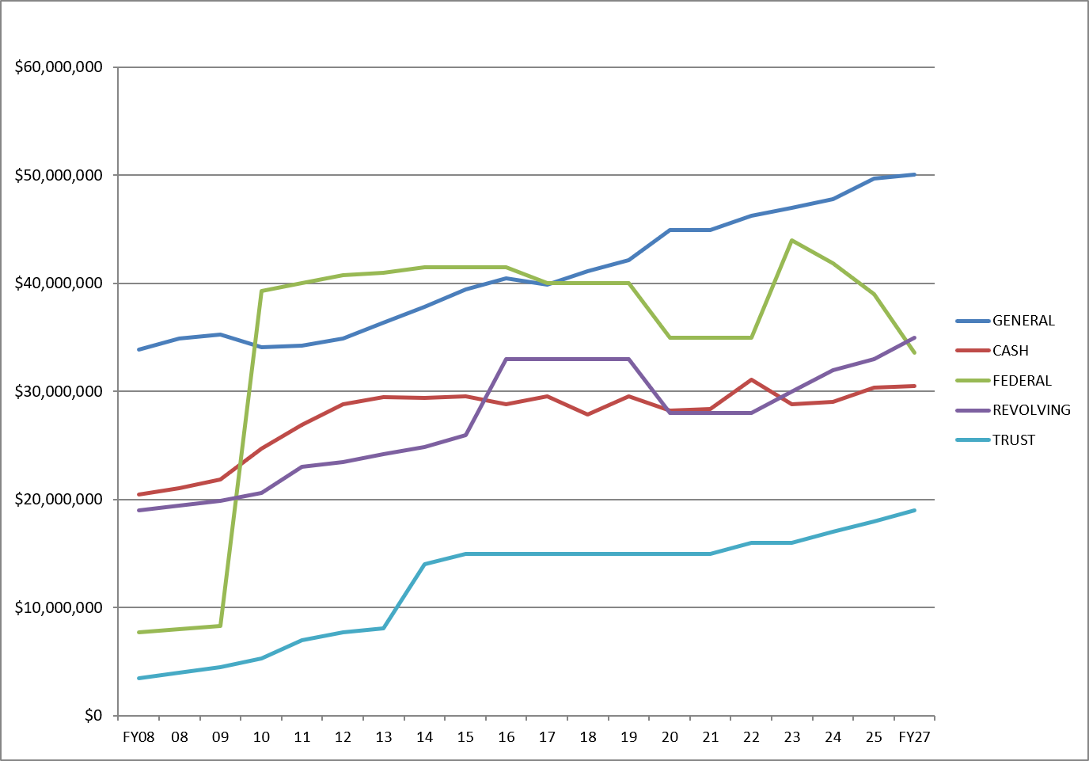
Historical Operating Budgets
Estimated Revenue by Fund Source

Slide 7
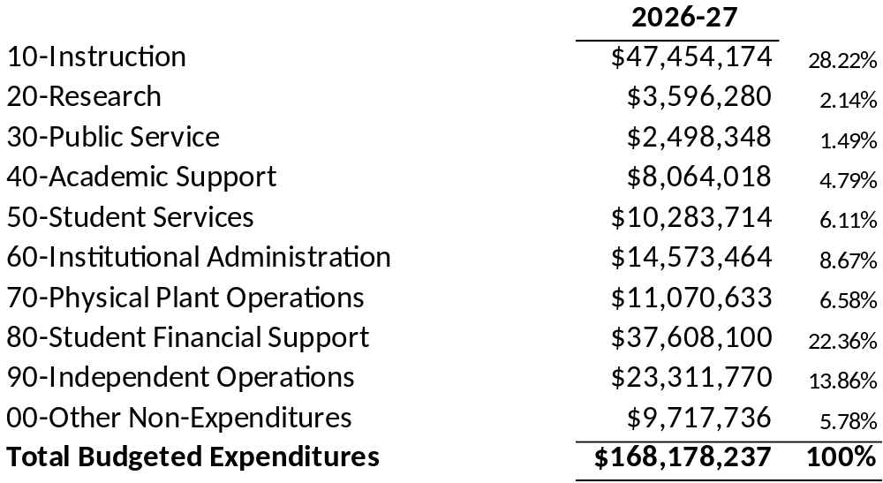
2026-27 Operating Budget
Budgeted Expenditures by Spending Category

Slide 8
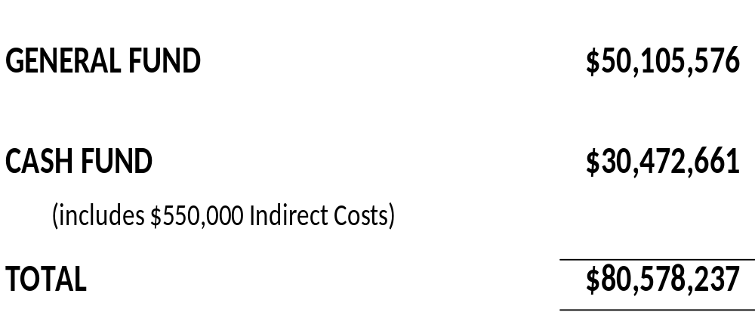
2026-27 State Aided Budget
State and University Generated-Unrestricted and Designated

Slide 9
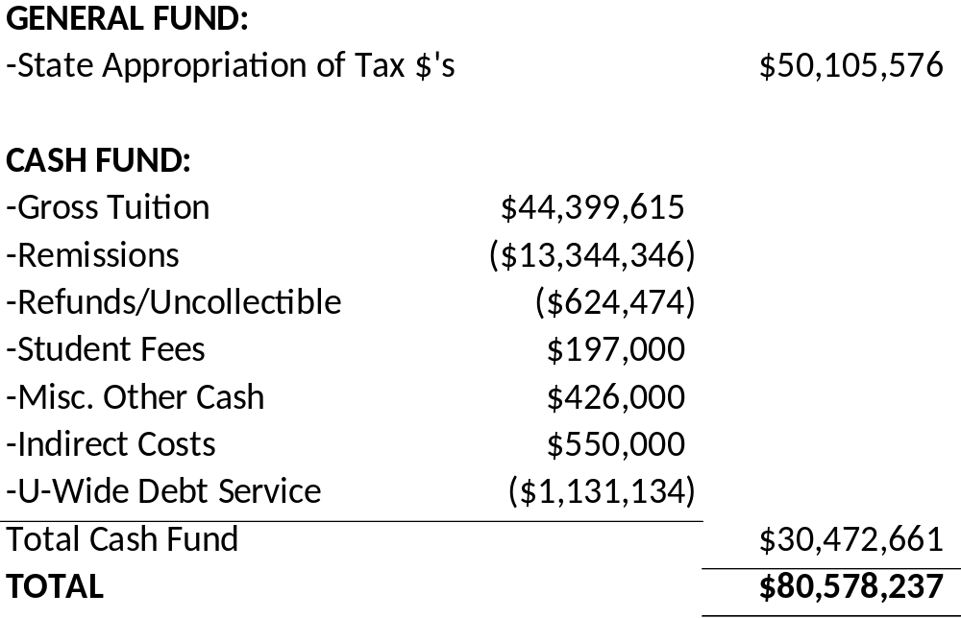
2026-27 State Aided Budget
State and University Generated-Unrestricted and Designated

Slide 10
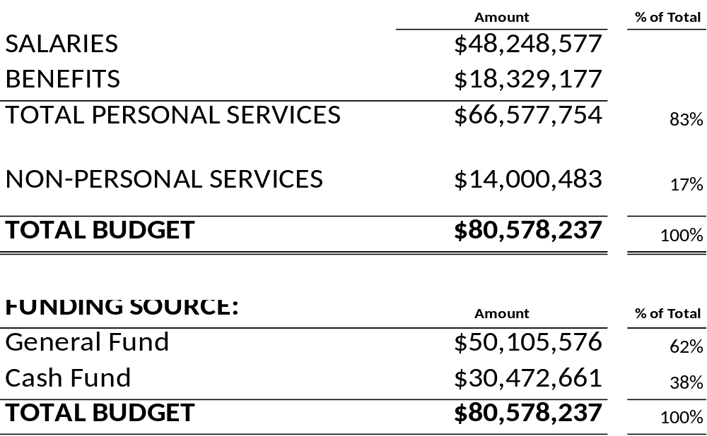
2026-27 State Aided Budget
State and University Generated-Unrestricted and Designated

Slide 11
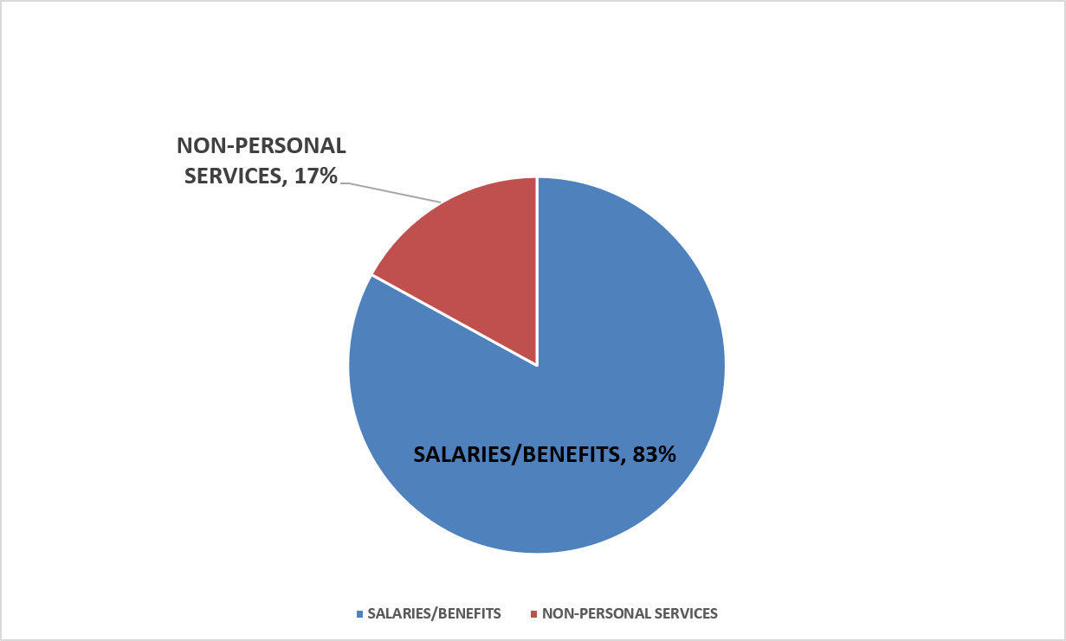
2026-27 State Aided Budget
State and University Generated-Unrestricted and Designated

Slide 12
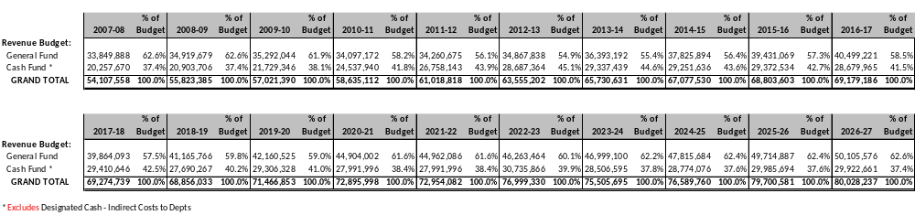
Historical State Aided Budget
State and University Generated-Unrestricted

Slide 13
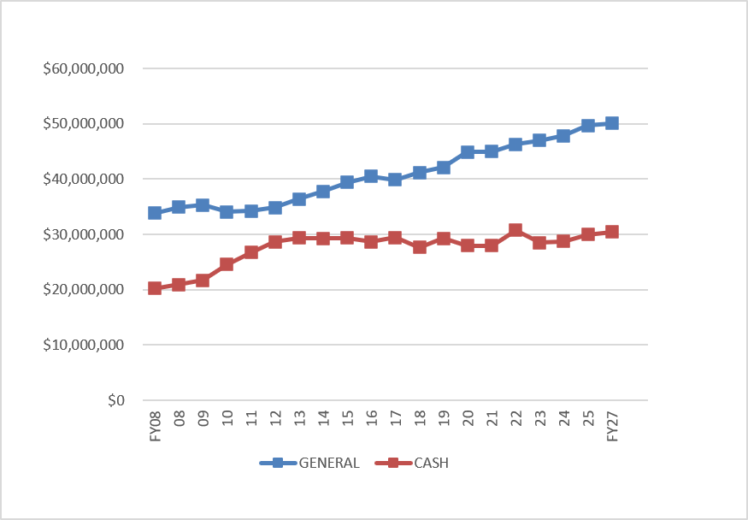
Historical State Aided Budget
State and University Generated-Unrestricted

Slide 14
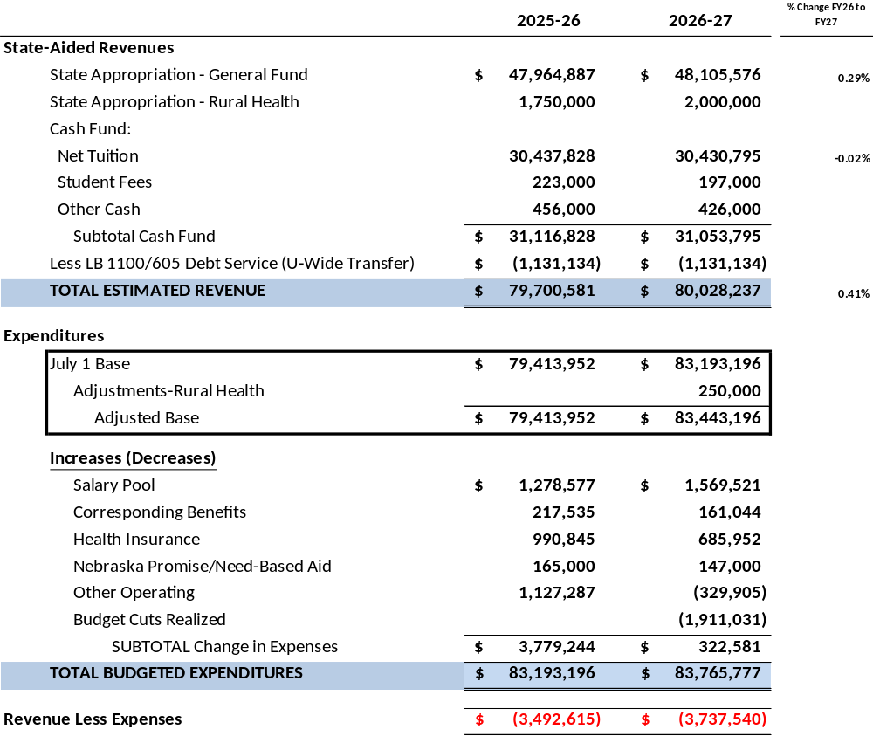
State Aided Budget Allocation Comparison
FY2026/FY2027 Biennium

Slide 15
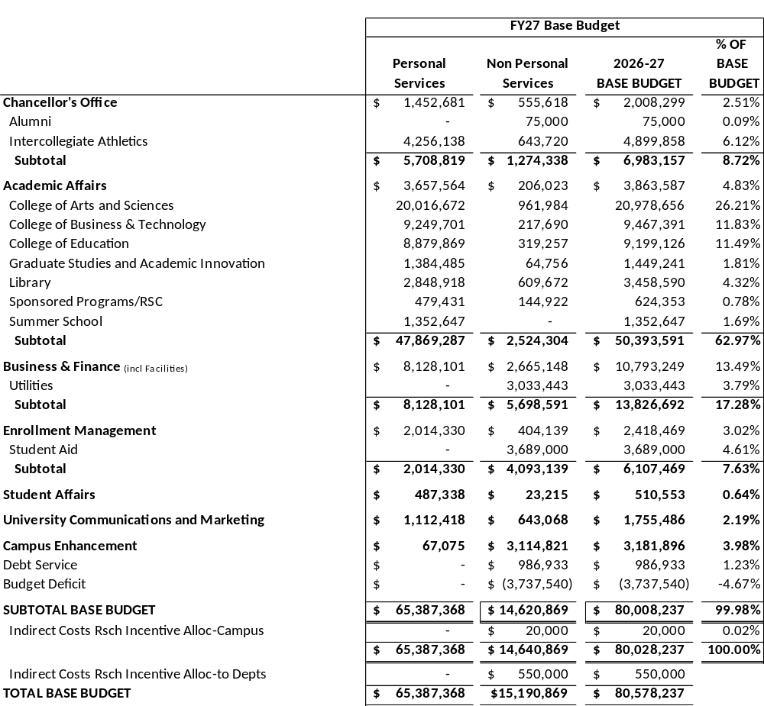
2026-27 General Operating Budget
State Aided Funds (Non-Revolving)

Slide 16
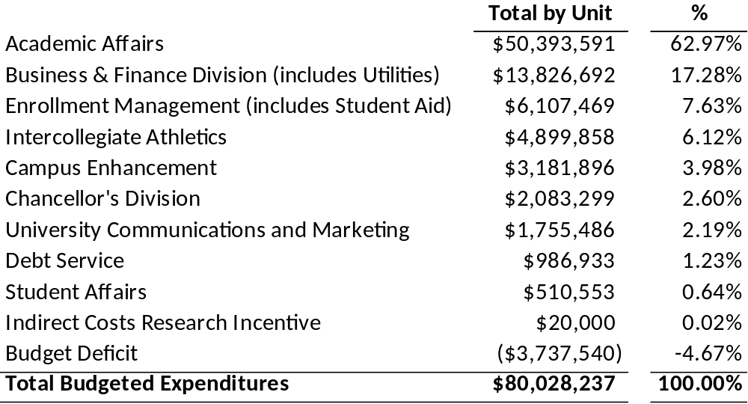
2026-27 General Operating Budget
State Aided Base Budget by Unit

Slide 17
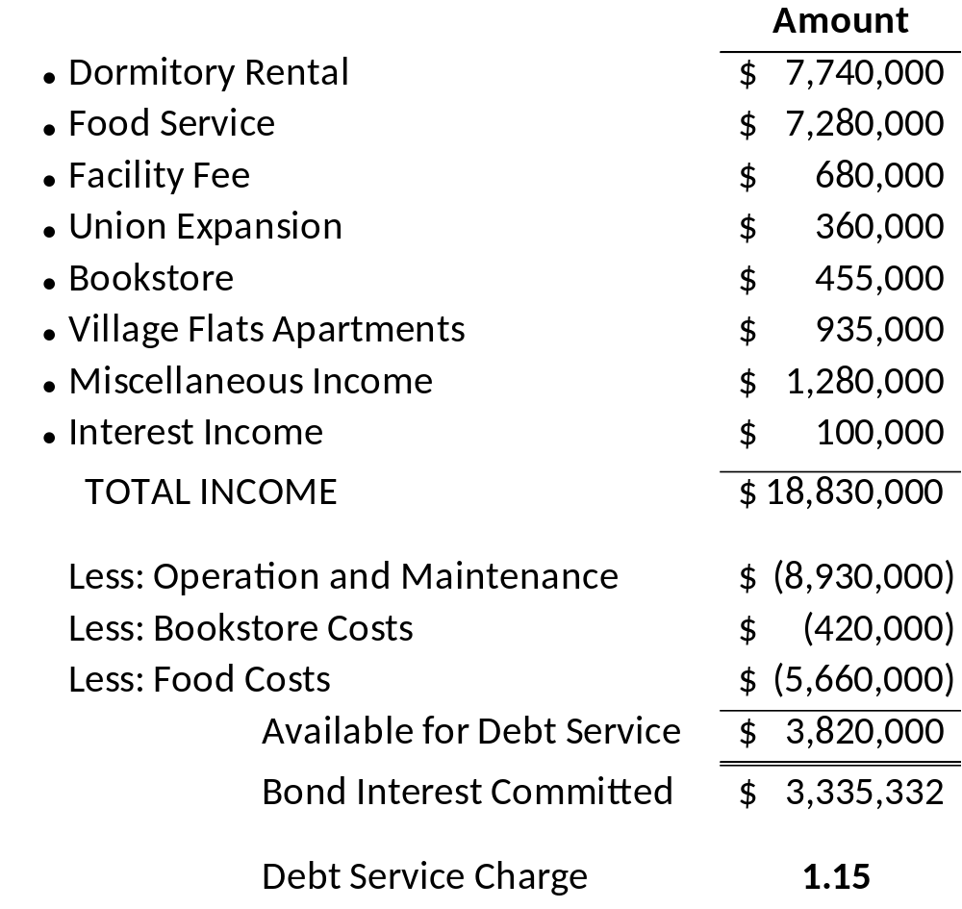
2026-27 Revenue Facilities
Operations and Maintenance Budget

Slide 18
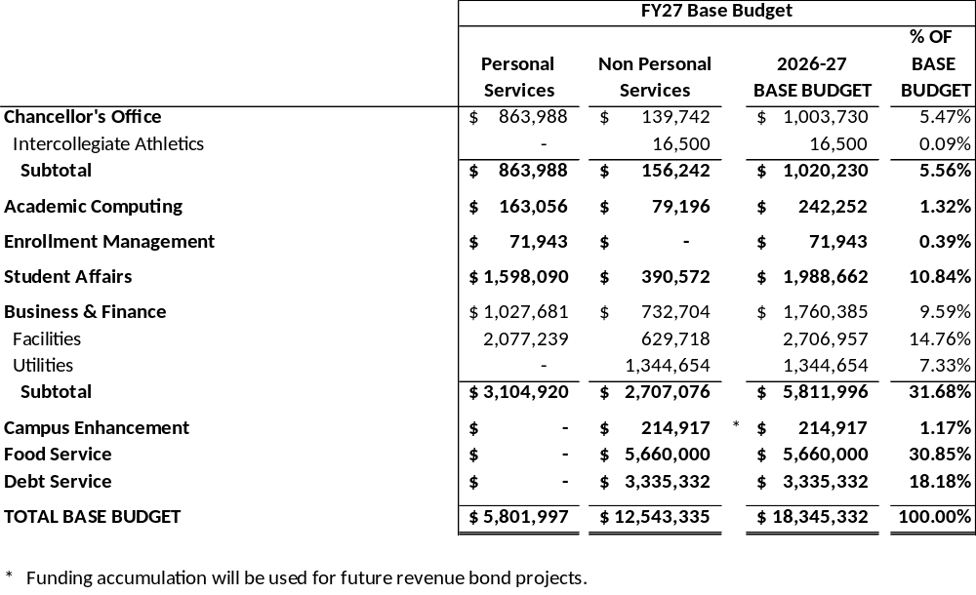
2026-27 Revenue Facilities
Operations and Maintenance Budget by Unit

Slide 19
Submit questions and comments to Vice Chancellor Scott Benson bensonsa1@unk.edu

