Slide 1

Budget Overview
Fiscal Year 2024-25

Slide 2

FUND DEFINITIONS
GENERAL FUND
  State tax revenue allocated to the University.
CASH FUNDS
  Derived from tuition, fees, investment income, and other miscellaneous income.
FEDERAL FUNDS
  Provided by federal agencies for research, grants and contracts, and student aid programs.
REVOLVING FUNDS
  Self-generated from departmental sales, charges for housing, food services, etc.
TRUST FUNDS
  State and private gifts, grants, and contracts, non-federal student aid programs, etc.

Slide 3
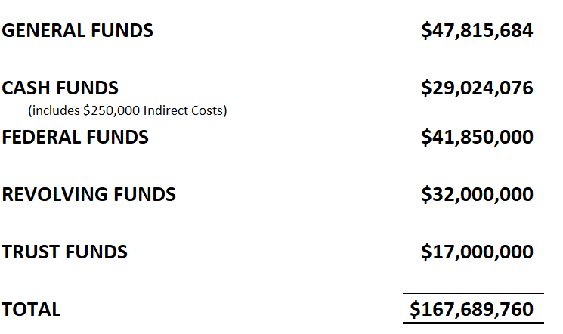
2024-25 Operating Budgets
Estimated Revenue by Fund Source

Slide 4
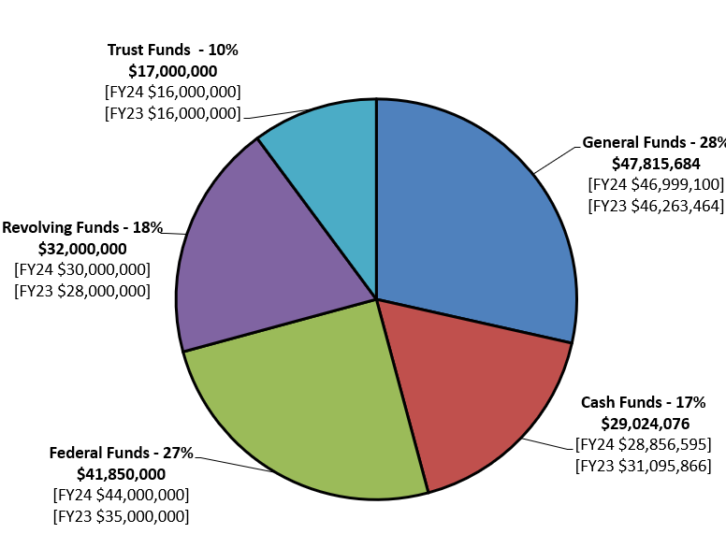
2024-25 Operating Budgets
Estimated Revenue by Fund Source

Slide 5
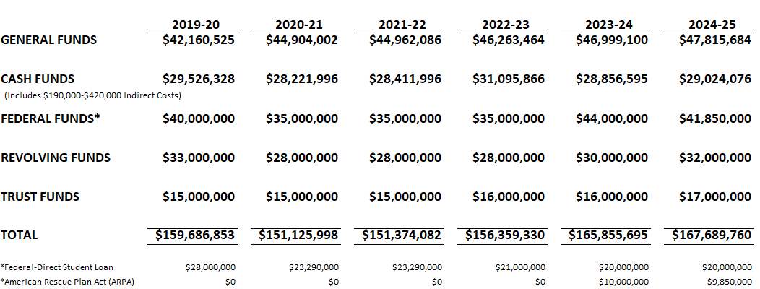
Historical Operating Budgets
Estimated Revenue by Fund Source

Slide 6
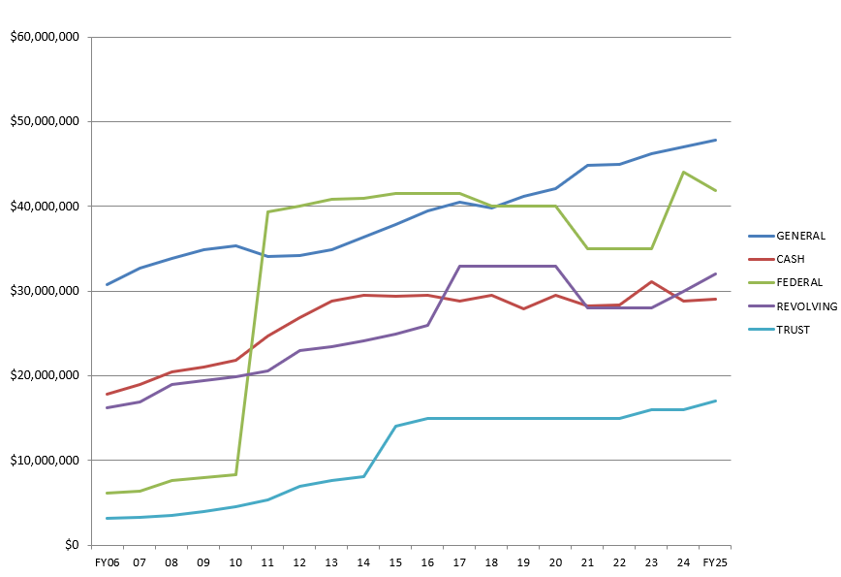
Historical Operating Budgets
Estimated Revenue by Fund Source

Slide 7
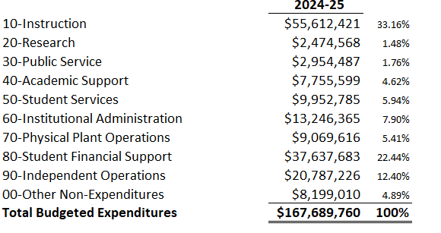
2024-25 Operating Budget
Budgeted Expenditures by Spending Category

Slide 8
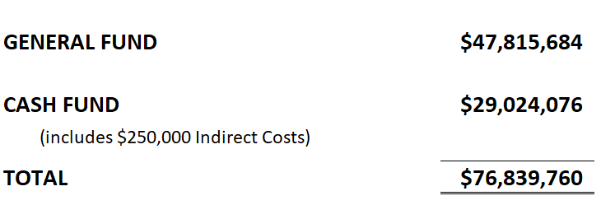
2024-25 State Aided Budget
State and University Generated-Unrestricted & Designated

Slide 9
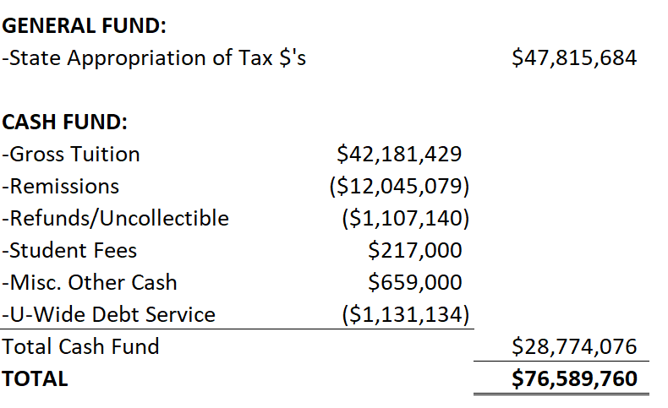
2024-25 State Aided Budget
State and University Generated-Unrestricted

Slide 10
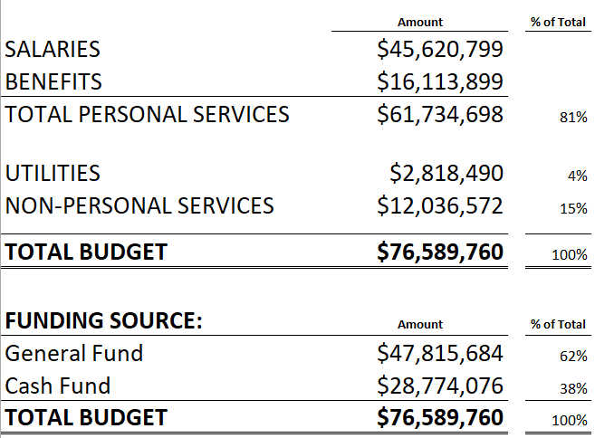
2024-25 State Aided Budget
State and University Generated-Unrestricted

Slide 11
2024-25 State Aided Budget
State and University Generated-Unrestricted

Slide 12
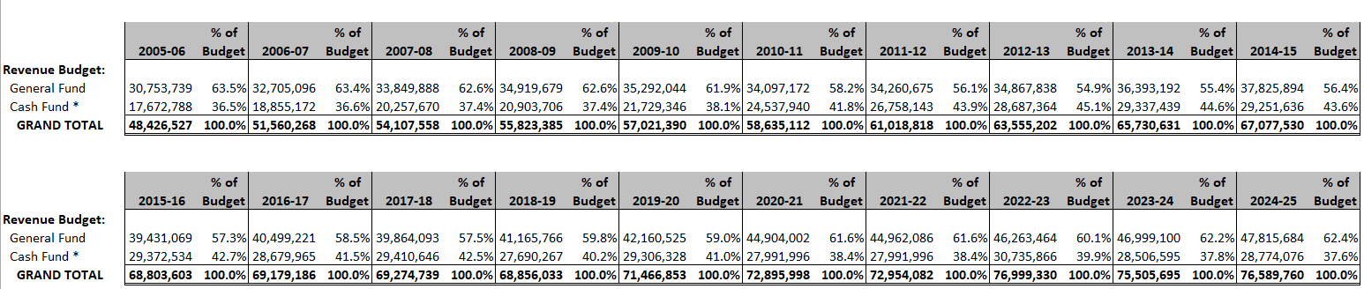
Historical State Aided Budget
State and University Generated-Unrestricted

Slide 13
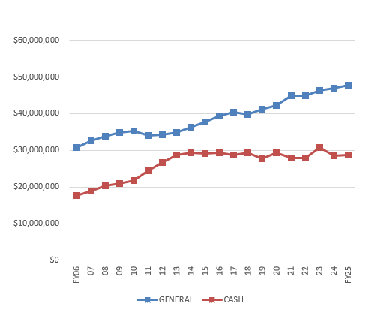
Historical State Aided Budget
State and University Generated-Unrestricted

Slide 14
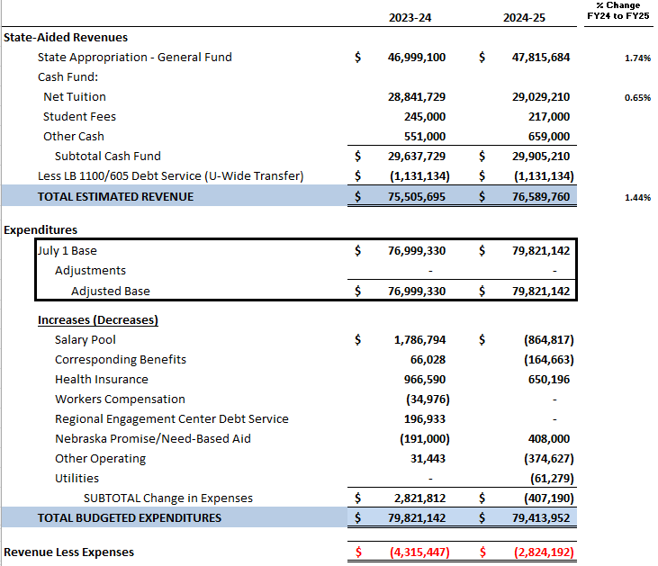
State Aided Budget Allocation Comparison
FY24 to FY25

Slide 15
2024-25 General Operating Budget
State Aided funds (Non-Revolving)

Slide 16
2024-25 General Operating Budget
State Aided Base Budget by Unit

Slide 17
Revenue Facilities Budget
FY2024-25

Slide 18
Revenue Facilities Budget by Unit
FY2024-25

Slide 19

Submit questions and comments to
Vice Chancellor Jon C. Watts
wattsjc@unk.edu

