Slide 1
UNIVERSITY OF NEBRASKA AT KEARNEY
BUDGET OVERVIEW
2021-22
Jon C. Watts
Vice Chancellor
Business and Finance
September 2021

Slide 2
FUND DEFINITIONS
GENERAL FUND
  State tax revenue allocated to the University.
CASH FUNDS
  Derived from tuition, fees, investment income, and other miscellaneous income.
FEDERAL FUNDS
  Provided by federal agencies for research, grants and contracts, and student aid programs.
REVOLVING FUNDS
  Self-generated from departmental sales, charges for housing, food services, etc.
TRUST FUNDS
  State and private gifts, grants, and contracts, non-federal student aid programs, etc.

Slide 5
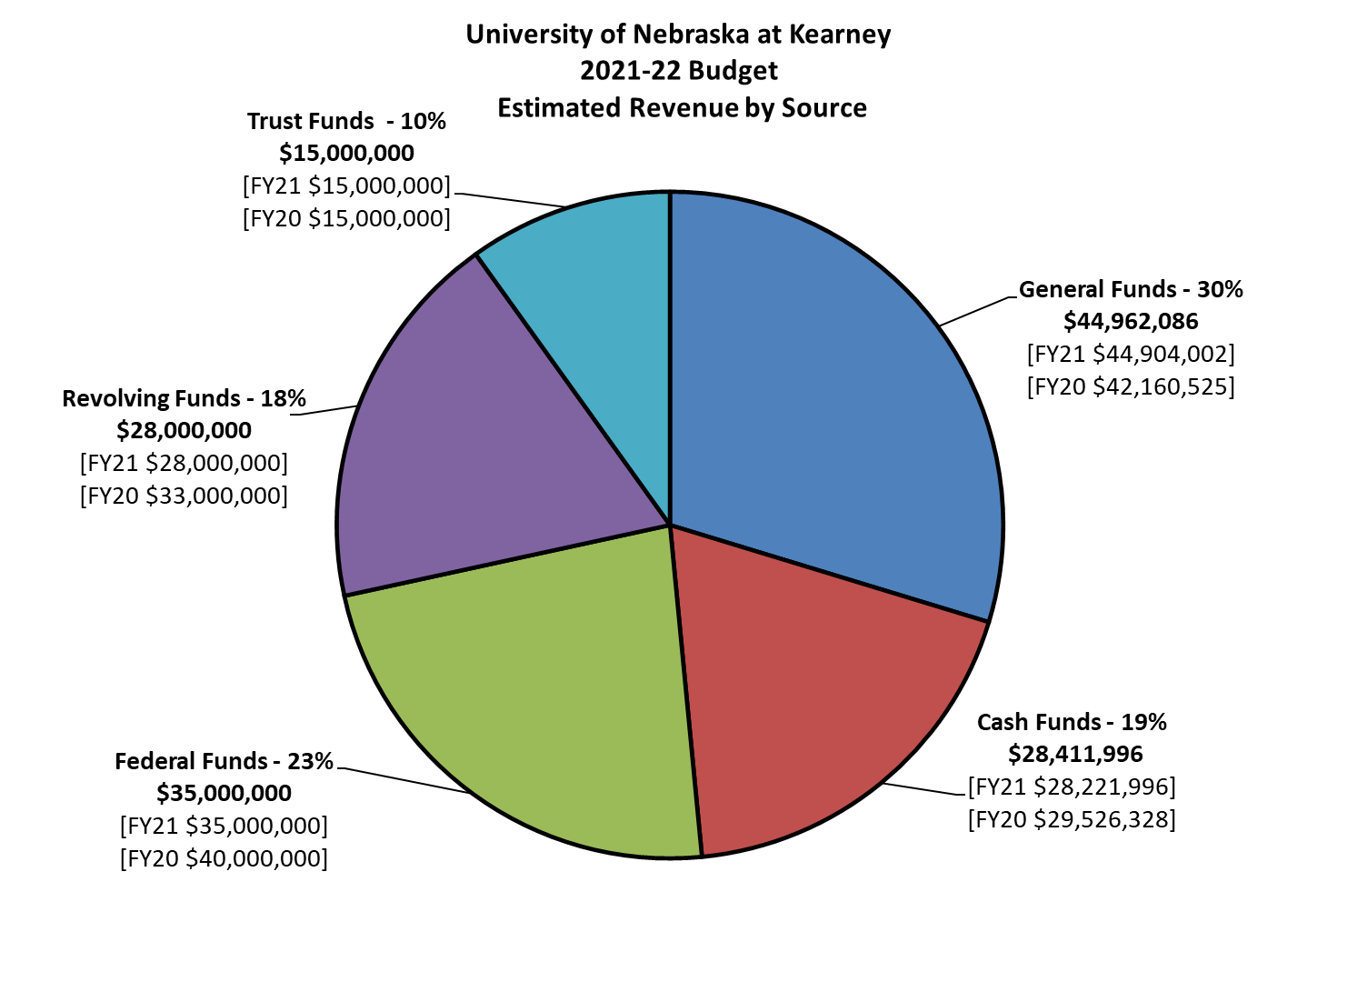

Slide 11
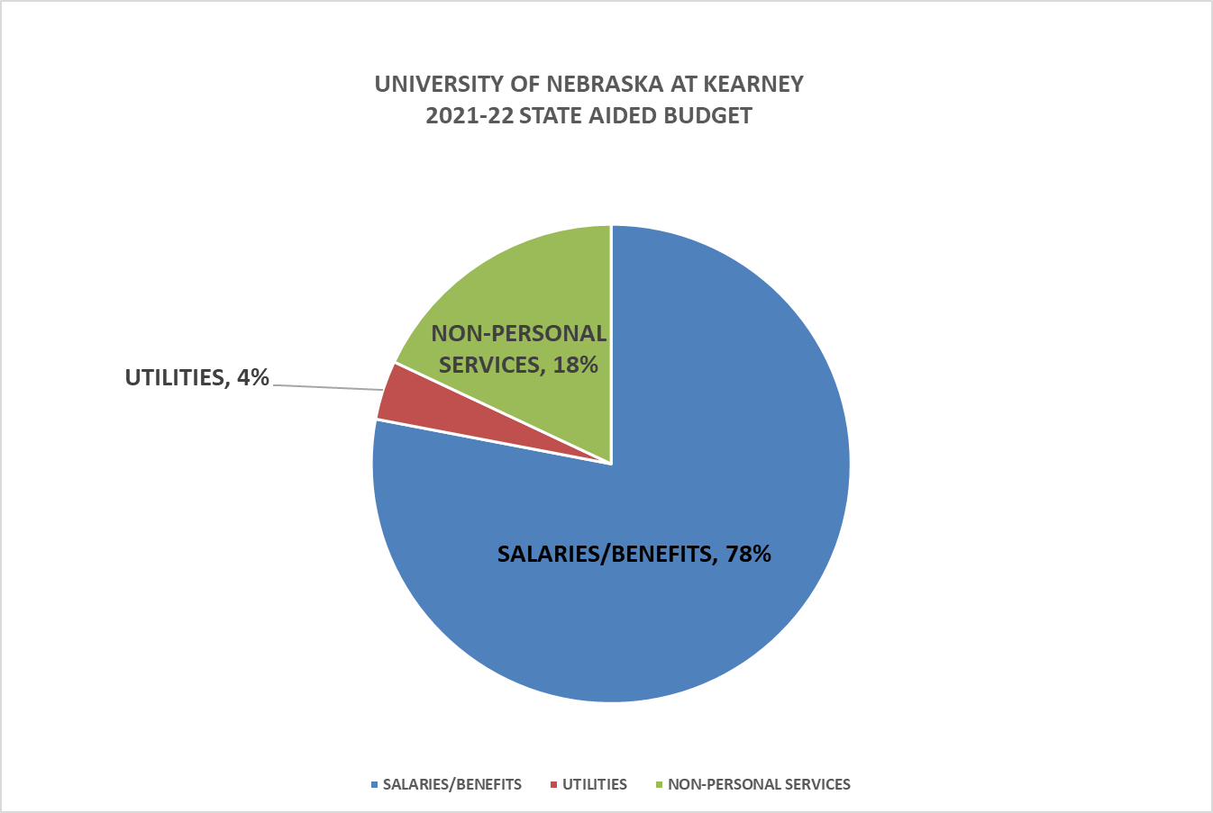

Slide 13
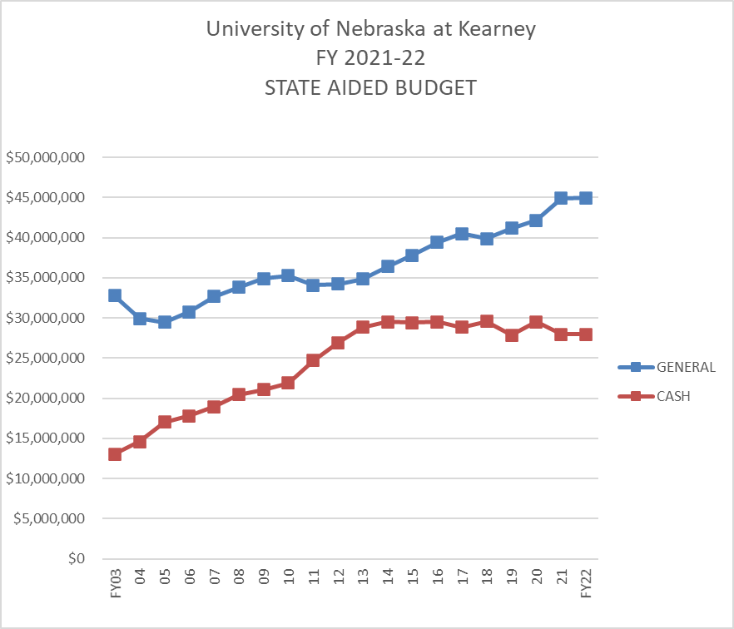

Slide 24
Questions or Comments Should Be Submitted To
Vice Chancellor Jon C. Watts wattsjc@unk.edu

