Slide 1
UNIVERSITY OF NEBRASKA AT KEARNEY
BUDGET OVERVIEW
2015-16
Barbara L. Johnson
Vice Chancellor
Business and Finance
November 2015

Slide 2
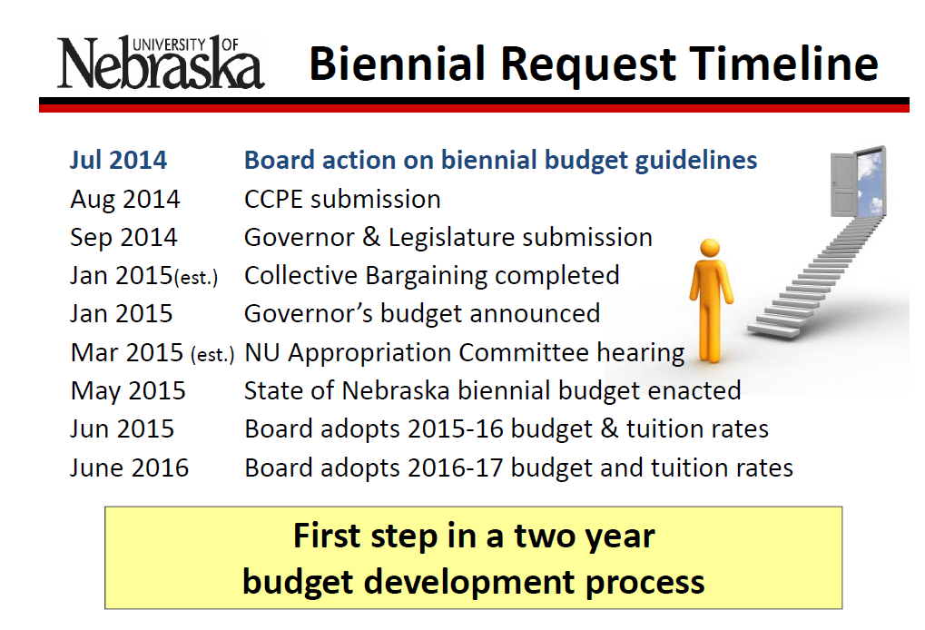

Slide 3
University of Nebraska at Kearney FY 2015-2016
Priorities
UNK Priorities
• Quality teaching & undergraduate research
  Conduct annual reviews of selected academic programs
  Enhance academic offerings with POE financial support
    Physics FY2016 and FY2017
    Management FY2017
    Teacher Education FY2017
  Increase the research opportunities for faculty and students working with the Director of Sponsored Programs and Director of Honors
  Continue to enhance our on-line offerings
Analyze and develop a long-term strategic plan for enrollment management with a focus on increasing overall enrollment and increasing both retention and our four-year graduation rates
  Areas of Focus:
    First Generation Students
    First Time Freshmen
    International Students
    Minority Students
    Transfer Students
Development of our next strategic plan

Slide 4
UNK Priorities Continued
• Facility capital renewal/new construction projects on the drawing board:
  Complete the design plan for University Heights replacement
  Otto Olsen II Replacement Plan (B & T , NSS , Fine Arts, IT & Child Care Center)
  Fine Arts Renovation Plan
  Develop Residential Capital Renewal Phase II
  Develop implementation timeline/renovation plan for the Nebraska Student Union
  Plan for the demolition of Conrad, East Heating Plant and Cranewood
Continue with the development and all related activities for University Village (South Campus) Project
Continue with the review of the student directory information and keyless entry for the entire campus, and a campus-wide surveillance system
• Coordinate with the City/NDOR to create safer crossings for pedestrians and vehicular traffic around the campus

Slide 5
FUND DEFINITIONS
GENERAL FUND
  State tax revenue allocated to the University.
CASH FUNDS
  Derived from tuition, fees, investment income, and other miscellaneous income.
FEDERAL FUNDS
  Provided by federal agencies for research, grants and contracts, and student aid programs.
REVOLVING FUNDS
  Self-generated from departmental sales, charges for housing, food services, etc.
TRUST FUNDS
  State and private gifts, grants, and contracts, non-federal student aid programs, etc.

Slide 9
UNK ALL FUNDS

Slide 11
2015-16 University of Nebraska at Kearney
Budgeted Revenue by Fund Source
Federal Funds | 41,500,000
Revolving Funds | 26,000,000
General Funds | 39,431,069
Trust Funds | 15,000,000
Cash Funds | 29,542,534
Total Estimated Funding | $151,473,603
2015-2016 University of Nebraska at Kearney
Estimated Expenditures by Spending Category
10-Instruction | 45,608,651
20-Research | 1,294,650
30-Public Service | 2,207,597
40-Academic Support | 8,601,278
50-Student Services | 7,009,159
60-Institutional Administration | 9,595,884
70-Physical Plant Operations | 8,442,151
80-Student Financial Support | 14,416,048
90-Independent Operations | 15,753,977
00-Other Non-Expenditures | 38,544,208
Total Budgeted Expenditures | $151,473,603

Slide 12
State Aided Budget
2015-16
(State and University Generated – Unrestricted & Designated)
General Fund $39,431,069
Cash Fund $29,542,534
            _________________
TOTAL $68,973,603
Notes:
General Fund: State Appropriation from Tax $’s $34,097,172
Cash Fund: Tuition Gross $32,042,401
Remissions <$6,100,520>
Refunds/Uncollectibles <$1,231,367>
Student Fees $ 249,560
Other Cash $ 709,000
U-Wide Debt Svc <$1,131,134>
TOTAL CASH $24,537,940
TOTAL UNRESTRICTED BUDGET $58,635,112

Slide 13
State Aided Budget
(State & University Generated – Unrestricted)
General Fund:
  State Appropriation of Tax $’s $39,431,069
Cash Funds:
  Gross Tuition $38,676,083
  Remissions ($ 8,040,945)
  Refunds/Uncollect ($ 1,087,065)
  Student Fees $ 258,595
  Misc Other Cash $ 697,000
  U-Wide Debt Svc ($ 1,131,134) $29,372,534
  TOTAL $68,803,603

Slide 16
UNIVERSITY OF NEBRASKA AT KEARNEY
State Aided Budget

Slide 17
STATE AIDED BUDGET
FY 2015-16
University of Nebraska at Kearney

Slide 23
BUDGET REDUCTION HISTORY
2001-02 Special Session ($ 288,246) (FY02)
2001-02 Special Session ($ 592,303) (FY03)
2001-02 April ($ 536,116) (FY03)
2002-03 July 1 ($1,208,572)
2003-04 July 1 ($1,675,828)
2004-05 July 1 ($ 86,335)
2005-06 July 1 ($ 531,021)
2006-07 July 1 $ 0
2007-08 July 1 ($ 243,893)
2008-09 July 1 ($ 385,401)
2009-10 July 1 ($ 794,059)
2009-10 Special Session ($ 342,763)
2010-11 July 1 ($1,086,478)
2011-12 July 1 ($ 368,430)
2012-13 July 1 $ 0
2013-14 July 1 $ 0
2014-15 July 1 $ 0
2015-16 July 1 ($ 176,764)_*
  TOTAL ($8,316,209)
  *Enrollment/Revenue Decline – Add’l Budget Reduction <988,880> = <$1,165,644>

Slide 24
TUITION INCREASE HISTORY
Tuition
2001-02 10.0%
2002-03 10.0%
2003-04 14.9%
2004-05 12.0%
2005-06 4.9%
2006-07 5.9%
2007-08 6.0%
2008-09 6.0%
2009-10 4.0%
2010-11 6.0%
2011-12 5.0%
2012-13 3.75%
2013-14 0.00% Res; 3% NonRes
2014-15 0.00% Res; 3% NonRes
2015-16 1.75%

Slide 25
REVENUE BOND BUDGET
(Designated/Restricted)
2015-16
Dormitory Rental $7,926,000
Food Service $7,171,000
Facility Fee $ 745,000
Union Expansion $ 480,000
Bookstore Commission $ 240,000
University Heights Apts $ 360,000
Misc Income $1,159,000
Interest Income $ 100,000
  TOTAL INCOME $ 18,181,000
  LESS OPERATION & MAINTENANCE ($8,755,000)
  LESS FOOD COSTS ($4,722,000)
  Available for Debt Service $4,704,000
  Bond Interest Committed $1,342,690
  Debt Service Charge 3.50

Slide 27
ROOM & BOARD INCREASE HISTORY
ROOM/Sem BOARD/Sem Per Year
2001-02 $1,008 +$88 $ 943 +$53 $3,902
2002-03 $1,071 +$63 $1,007 +$64 $4,156
2003-04 $1,146 +$75 $1,072 +$65 $4,436
2004-05 $1,289 +$143 $1,206 +$134 $4,990
2005-06 $1,376 +$87 $1,287 +$81 $5,326
2006-07 $1,469 +$93 $1,374 +$87 $5,686
2007-08 $1,550 +$81 $1,450 +$76 $6,000
2008-09 $1,635 +$85 $1,530 +$80 $6,330
2009-10 $1,725 +$90 $1,690 +$160 $6,830
2010-11 $1,820 +$95 $1,783 +$93 $7,206
2011-12 $1,911 +$91 $1,868 +$85 $7,558
2012-13 $2,007 +$96 $1,962 +$94 $7,938
2013-14 $2,107 +$100 $2,060 +$98 $8,434
2014-15 $2,212 +$105 $2,163 +$103 $8,880
2015-16 $2,300 +$88 $2,250 +$87 $9,230
Notes:
Room: Double
Board: FY11 21 meal 7-day +80 pts

Slide 28
FREQUENTLY ASKED QUESTIONS
Why does tuition increase when we want to keep attendance affordable?
We have annual increases in expenses, therefore, we increase tuition and fees to cover the increases in expenses. While 57% of our state budget is provided through state appropriations, this is not sufficient to cover all of our operating expenses.
What is our number one expenditure?
Compensation (salaries and benefits) which is 77% of our operating
budget.
What is the average amount of debt a student has when they graduate from UNK?
  All students do not have debt when they graduate. Nation wide, 34%
  of undergraduates do not have debt. At UNK those students that have debt usually have between $20,000-$21,000 of debt.
Will more classes and programs be offered on-line?
  The number of programs and courses that are available on-line is a
  market driven decision which is managed by the administrators of our on-line programs as well as the deans and faculty members.

Slide 29
QUESTIONS OR COMMENTS SHOULD BE SUBMITTED TO VICE CHANCELLOR BARBARA JOHNSON AT JOHNSONBL@UNK.EDU

