Slide 1
UNIVERSITY OF NEBRASKA AT KEARNEY
BUDGET OVERVIEW
2014-15
Barbara L. Johnson
Vice Chancellor
Business and Finance
October 1, 2014

Slide 2
University of Nebraska at Kearney FY 2014-2015 Priorities
UNK Priorities
• Quality teaching & undergraduate research
Conduct annual reviews of selected academic programs
Enhance academic offerings with POE financial support
Computer Science
Supply Chain Management
Visual Communications & Design
Increase the research opportunities for faculty and students working with the new Director of Sponsored Programs and the Director of the Honors Program
Continue to enhance our on-line offerings
Review and develop a long-term strategic plan for enrollment management with a focus on increasing overall enrollment and increasing both retention and our four-year graduation rates
• Healthier Nebraska initiative: Health Science Education Building/Programs (continue planning for fall 2015 grand opening
of the joint project between UNK and UNMC)
Development of our next strategic plan

Slide 3
UNK Priorities Continued
• Facility capital renewal/new construction projects on the drawing board:
Otto Olsen II Replacement Plan (B & T , NSS , Fine Arts, IT & Child Care Center)
Martin Hall Renovation Plan (Enrollment Management, Communications and Community Relations, Honors , Residential Life Administration, Others
Fine Arts Renovation Plan
Develop a redeployment plan for MSAB
Develop Residential Capital Renewal Phase II
Develop a significant renovation plan for the Nebraska Student Union
Plan for the demolition of Conrad, East Heating Plant and Cranewood
Continue with the development and all related activities for University Village (South Campus) Project
Continue with the review of our campus ID Card, student directory information and keyless entry for the entire campus
• Coordinate with the City/NDOR to create safer crossings for pedestrians and vehicular traffic around the campus
Complete our Capital Campaign by December 2014

Slide 4
FUND DEFINITIONS
GENERAL FUND
State tax revenue allocated to the University.
CASH FUNDS
Derived from tuition, fees, investment income, and other miscellaneous income.
FEDERAL FUNDS
Provided by federal agencies for research, grants and contracts, and student aid programs.
REVOLVING FUNDS
Self-generated from departmental sales, charges for housing, food services, etc.
TRUST FUNDS
State and private gifts, grants, and contracts, non-federal student aid programs, etc.

Slide 8
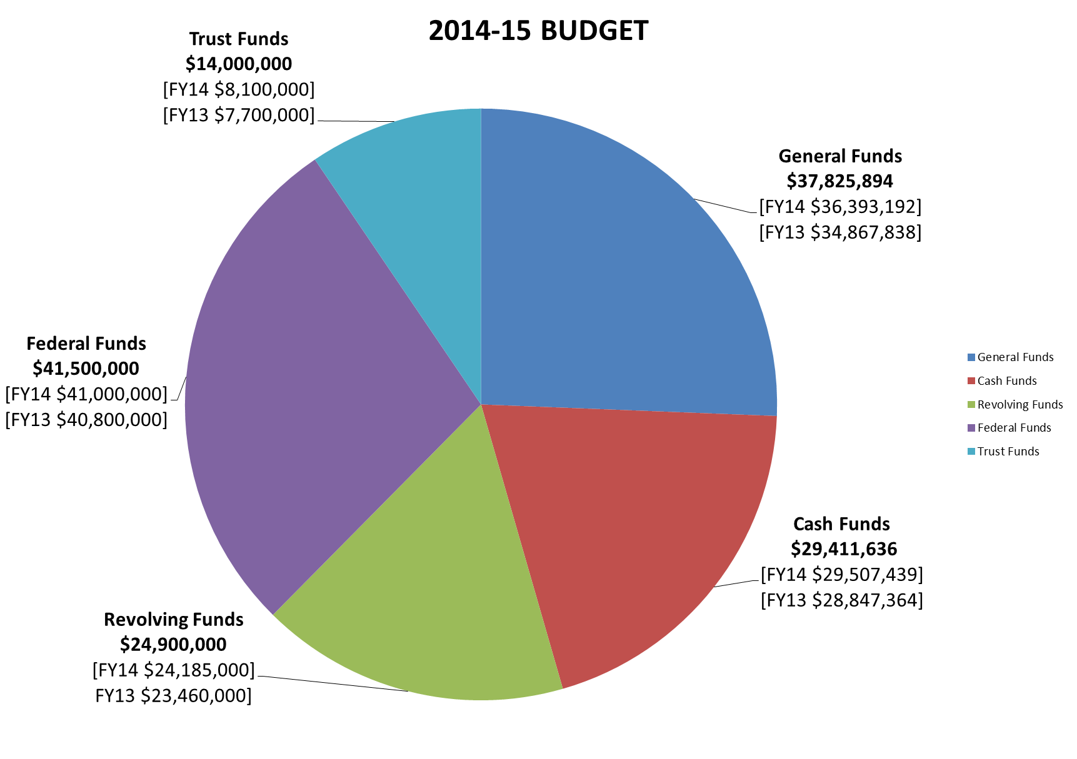
UNK ALL FUNDS

Slide 9
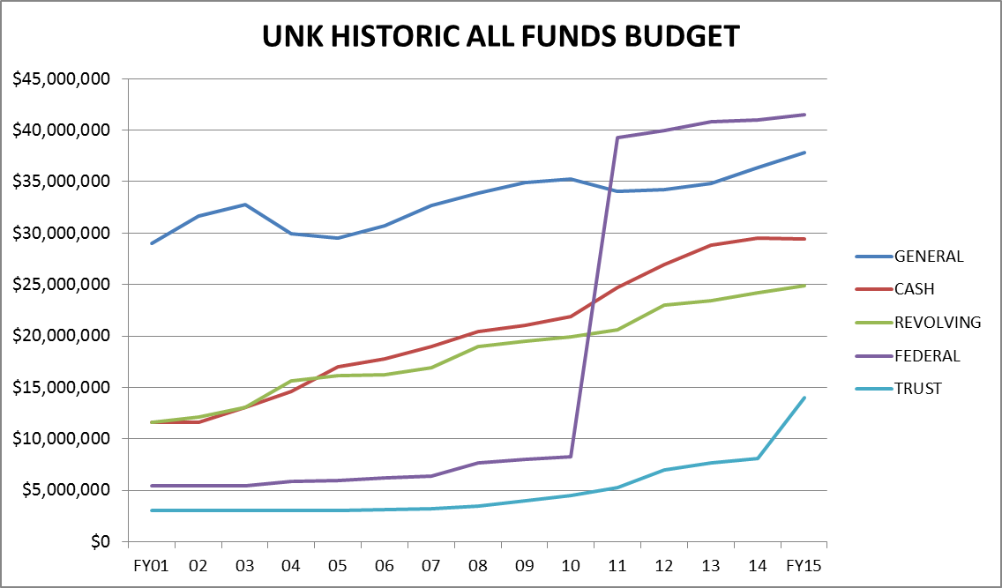

Slide 10
2014-15 University of Nebraska at Kearney Budgeted Revenue by Fund Source
Federal Funds | 41,500,000
Revolving Funds | 24,900,000
General Funds | 37,825,894
Trust Funds | 14,000,000
Cash Funds | 29,411,636
Total Estimated Funding | $147,637,530
2014-2015 University of Nebraska at Kearney Estimated Expenditures by Spending Category
10-Instruction | 44,624,255
20-Research | 1,277,995
30-Public Service | 1,678,598
40-Academic Support | 8,366,601
50-Student Services | 6,689,332
60-Institutional Administration | 8,928,874
70-Physical Plant Operations | 7,795,764
80-Student Financial Support | 13,831,479
90-Independent Operations | 15,800,083
00-Other Non-Expenditures | 38,644,549
Total Budgeted Expenditures | $147,637,530

Slide 11
State Aided Budget 2014-15 (State and University Generated – Unrestricted & Designated)
General Fund $37,825,894
Cash Fund $29,411,636
_________________
TOTAL $67,237,530
Notes:
General Fund: State Appropriation from Tax $’s $34,097,172
Cash Fund: Tuition Gross $32,042,401
Remissions <$6,100,520>
Refunds/Uncollectibles <$1,231,367>
Student Fees $ 249,560
Other Cash $ 709,000
U-Wide Debt Svc <$1,131,134>
TOTAL CASH $24,537,940
TOTAL UNRESTRICTED BUDGET $58,635,112

Slide 12
State Aided Budget (State & University Generated – Unrestricted)
General Fund:
State Appropriation of Tax $’s $37,825,894
Cash Funds:
Gross Tuition $38,631,474
Remissions ($ 8,040,945)
Refunds/Uncollect ($ 1,093,902)
Student Fees $ 261,475
Misc Other Cash $ 624,668
U-Wide Debt Svc ($ 1,131,134) $29,251,636
TOTAL $67,077,530

Slide 14
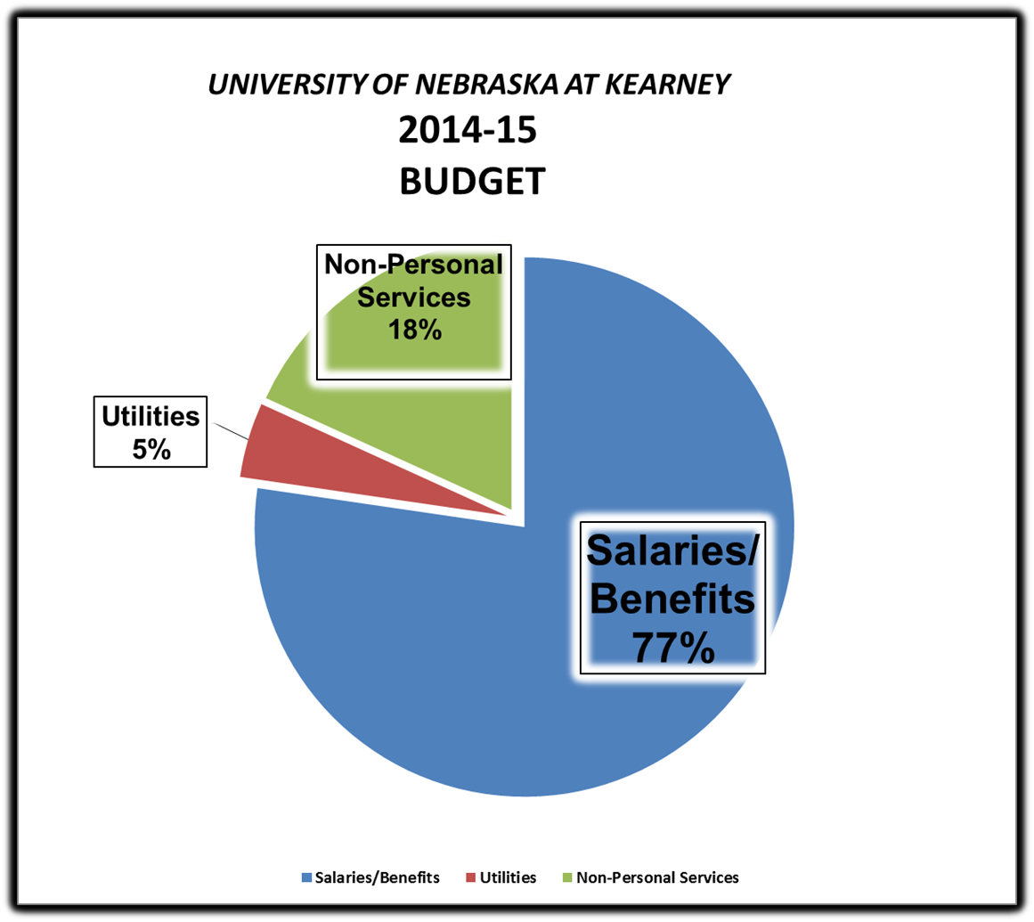

Slide 15
UNIVERSITY OF NEBRASKA AT KEARNEY State Aided Budget

Slide 16
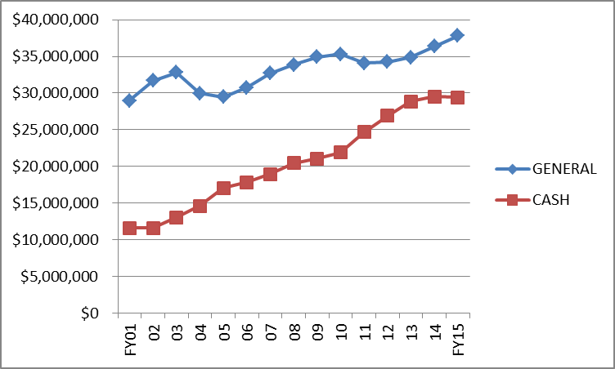
STATE AIDED BUDGET FY 2014-15 University of Nebraska at Kearney

Slide 22
BUDGET REDUCTION HISTORY
2001-02 Special Session ($ 288,246) (FY02)
2001-02 Special Session ($ 592,303) (FY03)
2001-02 April ($ 536,116) (FY03)
2002-03 July 1 ($1,208,572)
2003-04 July 1 ($1,675,828)
2004-05 July 1 ($ 86,335)
2005-06 July 1 ($ 531,021)
2006-07 July 1 $ 0
2007-08 July 1 ($ 243,893)
2008-09 July 1 ($ 385,401)
2009-10 July 1 ($ 794,059)
2009-10 Special Session ($ 342,763)
2010-11 July 1 ($1,086,478)
2011-12 July 1 ($ 368,430)
2012-13 July 1 $ 0
2013-14 July 1 $ 0
2014-15 July 1 $ 0_
TOTAL ($8,139,445)

Slide 23
TUITION INCREASE HISTORY
Tuition
2001-02 10.0%
2002-03 10.0%
2003-04 14.9%
2004-05 12.0%
2005-06 4.9%
2006-07 5.9%
2007-08 6.0%
2008-09 6.0%
2009-10 4.0%
2010-11 6.0%
2011-12 5.0%
2012-13 3.75%
2013-14 0.00% Res; 3% NonRes
2014-15 0.00% Res; 3% NonRes

Slide 24
REVENUE BOND BUDGET (Designated/Restricted) 2014-15
Dormitory Rental $7,700,000
Food Service $7,102,000
Facility Fee $ 780,000
Union Expansion $ 508,000
Bookstore Commission $ 210,000
University Heights Apts $ 350,000
Misc Income $1,024,000
Interest Income $ 100,000
TOTAL INCOME $ 17,774,000
LESS OPERATION & MAINTENANCE ($8,500,000)
LESS FOOD COSTS ($4,830,000)
Available for Debt Service $4,444,000
Bond Interest Committed $2,045,006
Debt Service Charge 2.17

Slide 26
ROOM & BOARD INCREASE HISTORY
ROOM/Sem BOARD/Sem Per Year
2001-02 $1,008 +$88 $ 943 +$53 $3,902
2002-03 $1,071 +$63 $1,007 +$64 $4,156
2003-04 $1,146 +$75 $1,072 +$65 $4,436
2004-05 $1,289 +$143 $1,206 +$134 $4,990
2005-06 $1,376 +$87 $1,287 +$81 $5,326
2006-07 $1,469 +$93 $1,374 +$87 $5,686
2007-08 $1,550 +$81 $1,450 +$76 $6,000
2008-09 $1,635 +$85 $1,530 +$80 $6,330
2009-10 $1,725 +$90 $1,690 +$160 $6,830
2010-11 $1,820 +$95 $1,783 +$93 $7,206
2011-12 $1,911 +$91 $1,868 +$85 $7,558
2012-13 $2,007 +$96 $1,962 +$94 $7,938
2013-14 $2,107 +100 $2,060 +$98 $8,434
2014-15 $2,212 +105 $2,163 +$103 $8,880
Notes:
Room: Double
Board: FY11 21 meal 7-day +80 pts

Slide 27
FREQUENTLY ASKED QUESTIONS
Why does tuition increase when we want to keep attendance affordable?
We have annual increases in expenses, therefore, we increase tuition and fees to cover the increases in expenses. While 56% of our state budget is provided through state appropriations, this is not sufficient to cover all of our operating expenses.
What is our number one expenditure?
Compensation (salaries and benefits) which is 77% of our operating
budget.
What is the average amount of debt a student has when they graduate from UNK?
All students do not have debt when they graduate. Nation wide, 34%
of undergraduates do not have debt. At UNK those students that have debt usually have between $20,000-$21,000 of debt.
Will more classes and programs be offered on-line?
The number of programs and courses that are available on-line is a
market driven decision which is managed by the administrators of our on-line programs as well as the deans and faculty members.

Slide 28
QUESTIONS OR COMMENTS SHOULD BE SUBMITTED TO VICE CHANCELLOR BARBARA JOHNSON AT JOHNSONBL@UNK.EDU

